Slide 1
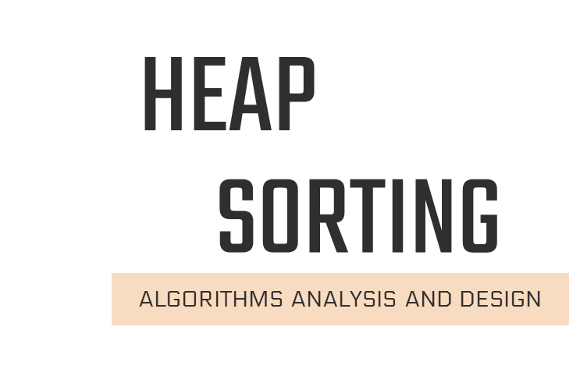

Slide 2
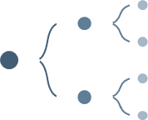
01
Complete binary tree
What we will talk about :
02
Heap&Heap sorting
03
Pseudocode
04
Conclusion applications

Slide 3
Sorting algorithms
1
Selection
2
Bubble
3
insertion
4
Merge
5
Quick
Do we have another
sort algorithm ?

Slide 4
Heap Sorting
Saturn
2
4
1
3
5

Slide 5
Complete Tree
A complete binary tree is a special type of binary tree where all the levels of the tree are filled completely except the lowest level nodes which are filled from
as left as possible

Slide 6
20 | 35 | 30 | 25 | 10 | 5 | 15
15
5
10
25
30
35
20

Slide 7
index
7 | 6 | 5 | 4 | 3 | 2 | 1
A
20 | 35 | 30 | 25 | 10 | 5 | 15
15
Index of Left child
Left(i): 2 *i
Left child for i=1
Left(1): 2 x 1=2
A[2]=5
5
10
Index of Right child
Right(i): 2 *i +1
Right child for i=1
Right(1): 2x1+1=3
A[3]=10
25
30
35
20
Index of parent
parents(i)= i/2
Parent (3)=3/2=1

Slide 8
Heaps are a type of data structure that can be either a "Max Heap" or a "Min Heap".
MAX
MIN
Heap
The value of the node is greater than or equal to its children nodes. The highest value node is the root node of the max heap.
The value of the node is less than or equal to its children nodes. The smallest value node is the root node of the min heap.

Slide 9
Is every complete
binary tree usable in Heap?

Slide 10
Is this a Heap ? If yes…what’s its type?
50
10
10
40
30
20
25
20
25
10
20
30
15
30
35
55
25
30
35
5
15
MAX Heap
MIN Heap
NOT Heap

Slide 11
Every HEAP is a Complete Binary Tree, but not every Complete Binary Tree has to be HEAP

Slide 12

MAX Heap
16
4
7
1
12
19
Step 1: Picture the array as a complete binary tree:
16
4
7
1
12
19

Slide 13
Step 2: convert it to MAX HEAP
16
16
4
7
4
19
swap
12
19
1
12
7
1
16
19
swap
12
19
12
16
swap
4
7
1
4
7
1

Slide 14
MAX Heap
16
4
7
1
12
19
19
12
16
1
4
7
19
12
16
1
4
7

Slide 15
Step 3 :Heap Sort
Take out biggest
19
12
16
Move the last element
to the root
1
4
7
Array A
Sorted:
12
16
1
4
7
19

Slide 16
HEAPIFY()
7
16
swap
12
16
12
7
1
4
1
4
Array A
Sorted:
Sorted:
Array A
7
12
16
1
4
19
16
12
7
1
4
19

Slide 17
Take out biggest
Move the last element
to the root
16
4
12
7
12
7
1
4
1
Sorted:
Array A
Sorted:
Array A
12
7
1
4
16
19
4
12
7
1
16
19

Slide 18
HEAPIFY()
swap
4
12
12
7
4
7
1
1
Array A
Sorted:
Array A
Sorted:
4
12
7
1
16
19
12
4
7
1
16
19

Slide 19
Take out biggest
12
Move the last
element to the
root
4
7
1
Sorted:
Array A
4
7
1
12
16
19

Slide 20
1
7
swap
4
7
4
1
Array A
Sorted:
Array A
Sorted:
1
4
7
12
16
19
7
4
1
12
16
19

Slide 21
Take out biggest
7
Move the last
element to the
root
4
1
Sorted:
Array A
1
4
7
12
16
19

Slide 22
HEAPIFY()
Take out biggest
Move the last
element to the root
4
swap
1
1
4
Sorted:
Sorted:
Array A
Array A
1
4
7
12
16
19
4
1
7
12
16
19

Slide 23
Take out biggest
1
Sorted:
1
4
7
12
16
19

Slide 24
Min Heap
1
50
100
25
Step 1: Picture the array as a complete binary tree:
1
50
100
25

Slide 25
Step 2: convert it to MIN HEAP
1
1
Swap
50
100
25
100
25
50

Slide 26
MIN Heap
1
50
100
25
1
25
100
50
1
25
100
50

Slide 27
Step 3 :Heap Sort
Take out Smallest
1
Move the last
element to the
root
25
100
50
Array A
Sorted:
25
100
50
1

Slide 28
HEAPIFY()
25
swap
50
50
100
25
100
Array A
Sorted:
25
50
100
1

Slide 29
Heap Sort:
Take out Smallest
25
Array A
Sorted:
50
100
50
100
25
1
100
50

Slide 30
HEAPIFY()
50
swap
100
100
50
Take out Smallest
50
100
Array A
Sorted:
100
50
25
1

Slide 31
Take out smallest
100
Sorted:
100
50
25
1

Slide 32
implementation of Heapsort:

Slide 33
implementation of Heapsort
heapify(int arr[], int n , int pos) {
int max = pos;
int L = 2 * pos + 1;
int R = 2 * pos + 2;
if (L < n && arr[L] > arr[max])
max = L;
if (R< n && arr[R] > arr[max])
max = R ;
if (max != pos) {
swap( arr[pos] , arr[max]);
heapify(arr, n, max); }}
Buildheap (int arr[] , int n ) {
for (int i = n / 2 - 1; i >= 0; i--)
heapify(arr, n, i);
heapsort (int i = n - 1; i >= 0; i--) {
swap(arr[0], arr[i]);
heapify(arr, i, 0);

Slide 34
Complexity of the Heap Sort Algorithm
Worst Case :
Average Case
Best Case
O(n log n)
O(n log n)
O(n log n)
To sort an unsorted list with 'n' number
of elements need to O(n logn)

Slide 35
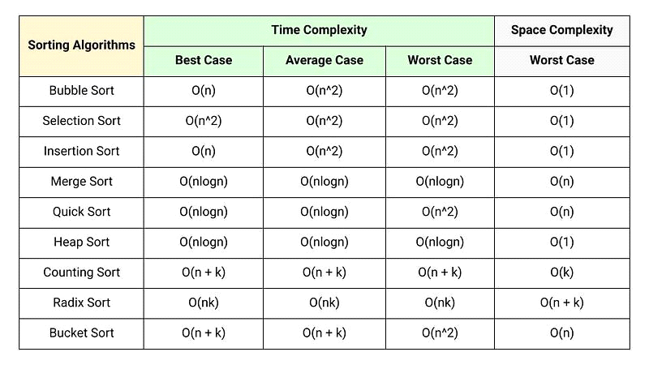

Slide 36
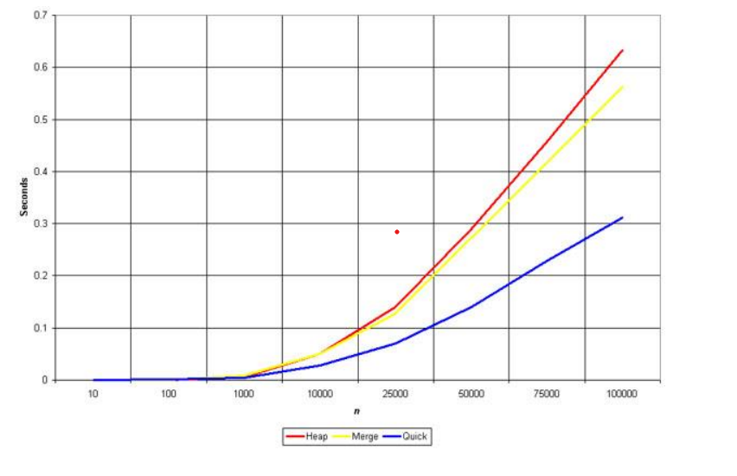
Comparison with Other Sorting Algorithms:

Slide 37
Applications of Heap sorting:

Slide 38
Applications:
Sorting large data
Implementing priority
Building a Huffman tree

Slide 39
Yara jehad Rabaya 202110451
Shereen Qarariya 202110917
Shyma’ khrewesh 202110883
Hala Jabareen 202111358
Malak Abualrob 202111533

